Slide 1
2
Introduction to C++ Programming

Slide 2
What’s in a name? that which we call a rose By any other name would smell as sweet.
  William Shakespeare
When faced with a decision, I always ask, “What would be the most fun?”
  Peggy Walker

Slide 3
“Take some more tea,” the March Hare said to Alice, very earnestly. “I’ve had nothing yet, “Alice replied in an offended tone: “so I can’t take more.” “You mean you can’t take less,” said the Hatter: “it’s very easy to take more than nothing.”
  Lewis Carroll
High thoughts must have high language.
  Aristophanes

Slide 4
OBJECTIVES
In this chapter you’ll learn:
To write simple computer programs in C++.
To write simple input and output statements.
To use fundamental types.
Basic computer memory concepts.
To use arithmetic operators.
The precedence of arithmetic operators.
To write simple decision-making statements.

Slide 5
2.1 Introduction
2.2 First Program in C++: Printing a Line of Text
2.3 Modifying Our First C++ Program
2.4 Another C++ Program: Adding Integers
2.5 Memory Concepts
2.6 Arithmetic
2.7 Decision Making: Equality and Relational Operators
2.8 (Optional) Software Engineering Case Study: Examining the ATM Requirements Document
2.9 Wrap-Up

Slide 6
2.1 Introduction
C++ programming
  Facilitates disciplined approach to computer program design
  Programs process information and display results
Five examples demonstrate
  How to display messages on the screen
  How to obtain information from the user
  How to perform arithmetic calculations
  How to make decisions by comparing numbers

Slide 7
2.2 First Program in C++: Printing a Line of Text
Simple program
  Prints a line of text
  Illustrates several important features of C++

Slide 8
2.2 First Program in C++: Printing a Line of Text (Cont.)
Comments
  Explain programs to you and other programmers
  Improve program readability
  Ignored by compiler
  Single-line comment
    Begins with //
    Example
      // This is a text-printing program.
  Multi-line comment
    Starts with /*
    Ends with */

Slide 9
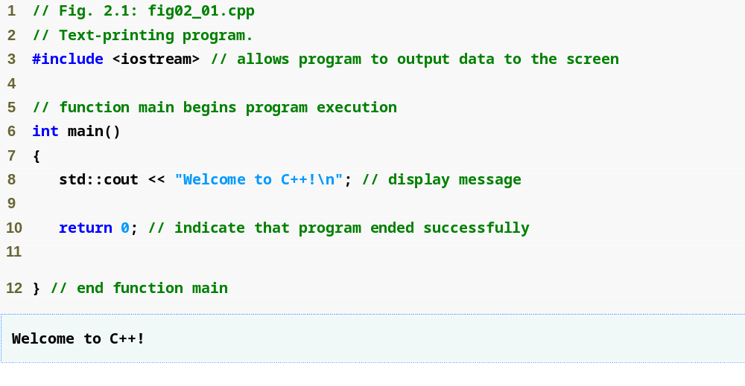
Outline
Single-line comments
Function main returns an integer value
Preprocessor directive to include input/output stream header file <iostream>
Left brace { begins function body
Function main appears exactly once in every C++ program
Statements end with a semicolon ;
fig02_01.cpp
(1 of 1)
fig02_01.cpp
output (1 of 1)
Corresponding right brace } ends function body
Stream insertion operator
Name cout belongs to namespace std
Keyword return is one of several means to exit a function; value 0 indicates that the program terminated successfully

Slide 10
Good Programming Practice 2.1
Every program should begin with a comment that describes the purpose of the program, author, date and time. (We are not showing the author, date and time in this book’s programs because this information would be redundant.)

Slide 11
2.2 First Program in C++: Printing a Line of Text (Cont.)
Preprocessor directives
  Processed by preprocessor before compiling
  Begin with #
  Example
    #include <iostream>
      Tells preprocessor to include the input/output stream header file <iostream>
White space
  Blank lines, space characters and tabs
  Used to make programs easier to read
  Ignored by the compiler

Slide 12
Common Programming Error 2.1
Forgetting to include the <iostream> header file in a program that inputs data from the key­board or outputs data to the screen causes the compiler to issue an error message, because the compiler cannot recognize references to the stream components (e.g., cout).

Slide 13
Good Programming Practice 2.2
Use blank lines and space characters to enhance program readability.

Slide 14
2.2 First Program in C++: Printing a Line of Text (Cont.)
Function main
  A part of every C++ program
    Exactly one function in a program must be main
  Can return a value
  Example
    int main()
      This main function returns an integer (whole number)
  Body is delimited by braces ({})
Statements
  Instruct the program to perform an action
  All statements end with a semicolon (;)

Slide 15
2.2 First Program in C++: Printing a Line of Text (Cont.)
Namespace
  std::
    Specifies using a name that belongs to “namespace” std
    Can be removed through the use of using statements
Standard output stream object
  std::cout
    “Connected” to screen
    Defined in input/output stream header file <iostream>

Slide 16
2.2 First Program in C++: Printing a Line of Text (Cont.)
Stream insertion operator <<
  Value to right (right operand) inserted into left operand
  Example
    std::cout << "Hello";
      Inserts the string "Hello" into the standard output
        Displays to the screen
Escape characters
  A character preceded by "\"
    Indicates “special” character output
  Example
    "\n"
      Cursor moves to beginning of next line on the screen

Slide 17
Common Programming Error 2.2
Omitting the semicolon at the end of a C++ statement is a syntax error. (Again, preprocessor directives do not end in a semicolon.) The syntax of a programming language specifies the rules for creating a proper program in that language. A syntax error occurs when the compiler encounters code that violates C++’s language rules (i.e., its syntax). The compiler normally issues an error message to help the programmer locate and fix the incorrect code. (cont…)

Slide 18
Common Programming Error 2.2
Syntax errors are also called compiler errors, compile-time errors or compilation errors, because the compiler detects them during the compilation phase. You will be unable to execute your program until you correct all the syntax errors in it. As you’ll see, some compilation errors are not syntax errors.

Slide 19
2.2 First Program in C++: Printing a Line of Text (Cont.)
return statement
  One of several means to exit a function
  When used at the end of main
    The value 0 indicates the program terminated successfully
    Example
      return 0;

Slide 20
Good Programming Practice 2.3
Many programmers make the last character printed by a function a newline (\n). This ensures that the function will leave the screen cursor positioned at the beginning of a new line. Conventions of this nature encourage software reusability—a key goal in software development.

Slide 21
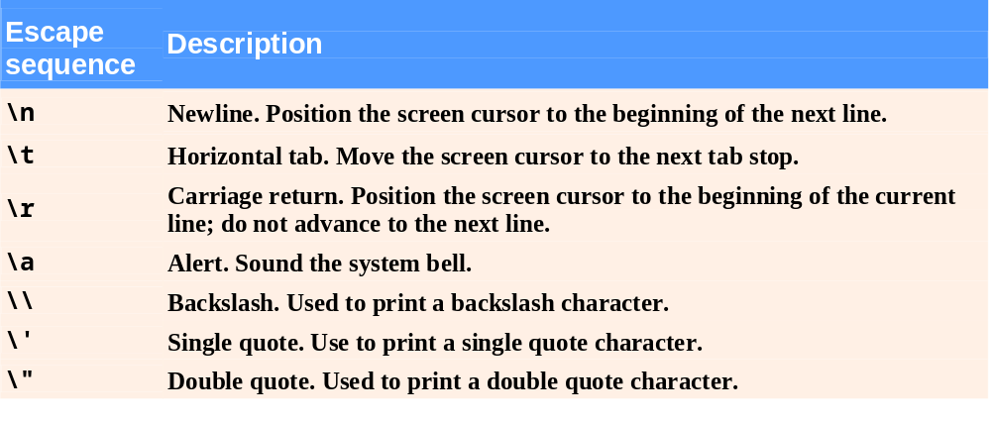
Fig. 2.2 | Escape sequences.

Slide 22
Good Programming Practice 2.4
Indent the entire body of each function one level within the braces that delimit the body of the function. This makes a program’s functional structure stand out and helps make the program easier to read.

Slide 23
Good Programming Practice 2.5
Set a convention for the size of indent you prefer, then apply it uniformly. The tab key may be used to create indents, but tab stops may vary. We recommend using either 1/4-inch tab stops or (preferably) three spaces to form a level of indent.

Slide 24
2.3 Modifying Our First C++ Program
Two examples
  Print text on one line using multiple statements (Fig. 2.3)
    Each stream insertion resumes printing where the previous one stopped
  Print text on several lines using a single statement (Fig. 2.4)
    Each newline escape sequence positions the cursor to the beginning of the next line
    Two newline characters back-to-back outputs a blank line

Slide 25
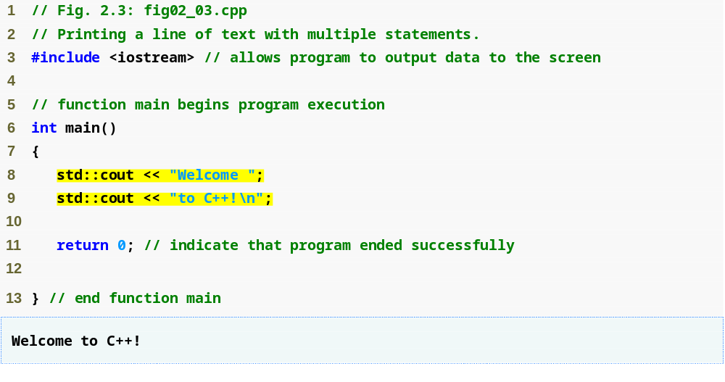
Outline
Multiple stream insertion statements produce one line of output because line 8 ends without a newline
fig02_03.cpp
(1 of 1)
fig02_03.cpp output (1 of 1)

Slide 26
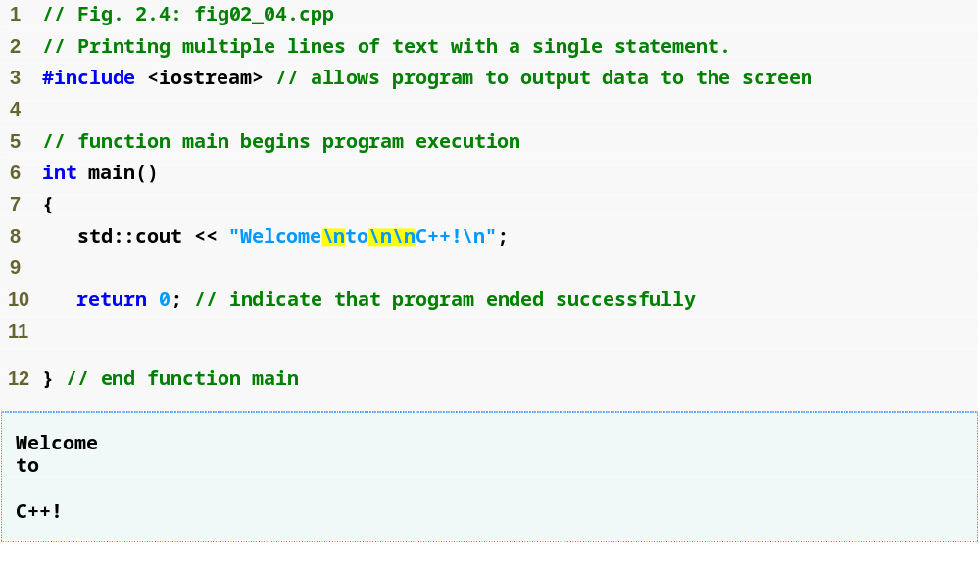
Outline
Use newline characters to print on multiple lines
fig02_04.cpp
(1 of 1)
fig02_04.cpp output (1 of 1)

Slide 27
2.4 Another C++ Program: Adding Integers
Variable
  Is a location in memory where a value can be stored
  Common data types (fundamental, primitive or built-in)
    int – for integer numbers
    char – for characters
    double – for floating point numbers
  Declare variables with data type and name before use
    int integer1;
    int integer2;
    int sum;

Slide 28
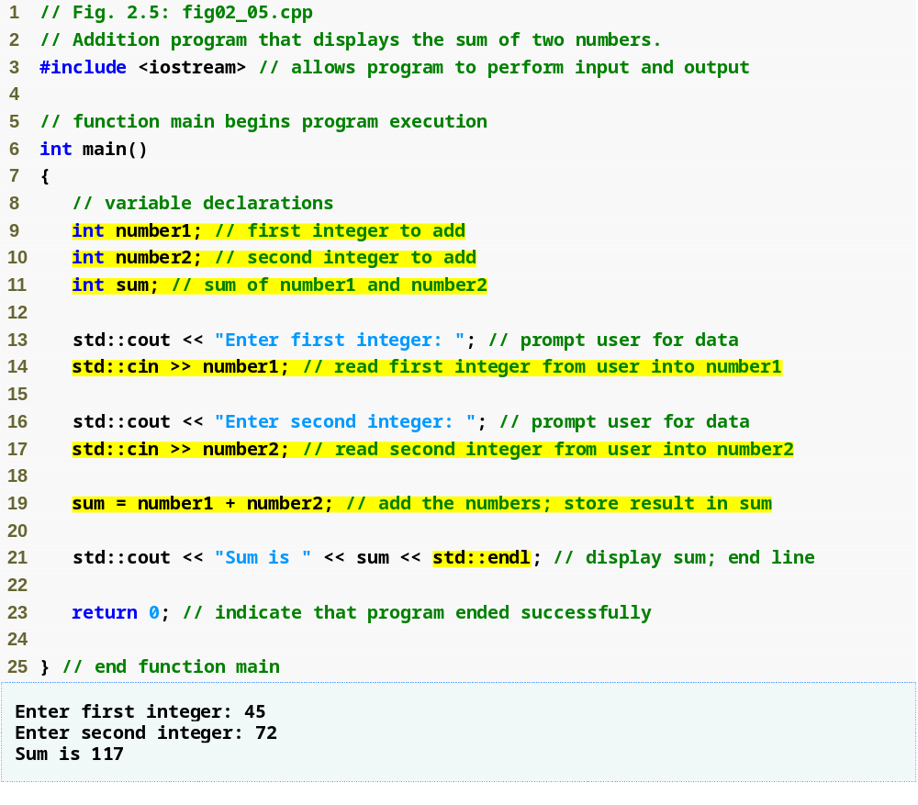
Outline
fig02_05.cpp
(1 of 1)
fig02_05.cpp output (1 of 1)
Declare integer variables
Use stream extraction operator with standard input stream to obtain user input
Stream manipulator std::endl outputs a newline, then “flushes” output buffer
Concatenating, chaining or cascading stream insertion operations

Slide 29
2.4 Another C++ Program: Adding Integers (Cont.)
Variables (Cont.)
  You can declare several variables of same type in one declaration
    Comma-separated list
    int integer1, integer2, sum;
  Variable name
    Must be a valid identifier
      Series of characters (letters, digits, underscores)
      Cannot begin with digit
      Case sensitive (uppercase letters are different from lowercase letters)

Slide 30
Good Programming Practice 2.6
Place a space after each comma (,) to make programs more readable.

Slide 31
Good Programming Practice 2.7
Some programmers prefer to declare each variable on a separate line. This format allows you to place a descriptive comment next to each declaration.

Slide 32
Portability Tip 2.1
C++ allows identifiers of any length, but your C++ implementation may impose some restrictions on the length of identifiers. Use identifiers of 31 characters or fewer to ensure portability.

Slide 33
Good Programming Practice 2.8
Choosing meaningful identifiers helps make a program self-documenting—a person can understand the program simply by reading it rather than having to refer to manuals or comments.

Slide 34
Good Programming Practice 2.9
Avoid using abbreviations in identifiers. This promotes program readability.

Slide 35
Good Programming Practice 2.10
Avoid identifiers that begin with underscores and double underscores, because C++ compilers may use names like that for their own purposes internally. This will prevent names you choose from being confused with names the compilers choose.

Slide 36
Error-Prevention Tip 2.1
Languages like C++ are “moving targets.” As they evolve, more keywords could be added to the language. Avoid using “loaded” words like “object” as identifiers. Even though “object” is not currently a keyword in C++, it could become one; therefore, future compiling with new compilers could break existing code.

Slide 37
Good Programming Practice 2.11
Always place a blank line between a declaration and adjacent executable statements. This makes the declarations stand out in the program and contributes to program clarity.

Slide 38
Good Programming Practice 2.12
If you prefer to place declarations at the beginning of a function, separate them from the executable statements in that function with one blank line to highlight where the declarations end and the executable statements begin.

Slide 39
2.4 Another C++ Program: Adding Integers (Cont.)
Input stream object
  std::cin from <iostream>
    Usually connected to keyboard
    Stream extraction operator >>
      Waits for user to input value, press Enter (Return) key
      Stores a value in the variable to the right of the operator
        Converts the value to the variable’s data type
    Example
      std::cin >> number1;
        Reads an integer typed at the keyboard
        Stores the integer in variable number1

Slide 40
Error-Prevention Tip 2.2
Programs should validate the correctness of all input values to prevent erroneous information from affecting a program’s calculations.

Slide 41
2.4 Another C++ Program: Adding Integers (Cont.)
Assignment operator =
  Assigns the value on the right to the variable on the left
  Binary operator (two operands)
  Example:
    sum = variable1 + variable2;
      Adds the values of variable1 and variable2
      Stores the result in the variable sum
Stream manipulator std::endl
  Outputs a newline
  Flushes the output buffer

Slide 42
Good Programming Practice 2.13
Place spaces on either side of a binary operator. This makes the operator stand out and makes the program more readable.

Slide 43
2.4 Another C++ Program: Adding Integers (Cont.)
Concatenating stream insertion operations
  Use multiple stream insertion operators in a single statement
    Stream insertion operation knows how to output each type of data
  Also called chaining or cascading
  Example
    std::cout << "Sum is " << number1 + number2
    << std::endl;
      Outputs "Sum is “
      Then outputs the sum of variables number1 and number2
      Then outputs a newline and flushes the output buffer

Slide 44
2.5 Memory Concepts
Variable names
  Correspond to actual locations in the computer's memory
    Every variable has a name, a type, a size and a value
  When a new value placed into a variable, the new value overwrites the old value
    Writing to memory is “destructive”
  Reading variables from memory is nondestructive
  Example
    sum = number1 + number2;
      Although the value of sum is overwritten
      The values of number1 and number2 remain intact

Slide 45
Fig. 2.6 | Memory location showing the name and value of variable number1.

Slide 46

Fig. 2.7 | Memory locations after storing values for number1 and number2.

Slide 47

Fig. 2.8 | Memory locations after calculating and storing the sum of number1 and number2.

Slide 48
2.6 Arithmetic
Arithmetic operators
  *
    Multiplication
  /
    Division
    Integer division truncates (discards) the remainder
      7 / 5 evaluates to 1
  %
    The modulus operator returns the remainder
      7 % 5 evaluates to 2

Slide 49
Common Programming Error 2.3
Attempting to use the modulus operator (%) with noninteger operands is a compilation error.

Slide 50
2.6 Arithmetic (Cont.)
Straight-line form
  Required for arithmetic expressions in C++
  All constants, variables and operators appear in a straight line
Grouping subexpressions
  Parentheses are used in C++ expressions to group subexpressions
    In the same manner as in algebraic expressions
  Example
    a * ( b + c )
      Multiple a times the quantity b + c

Slide 51
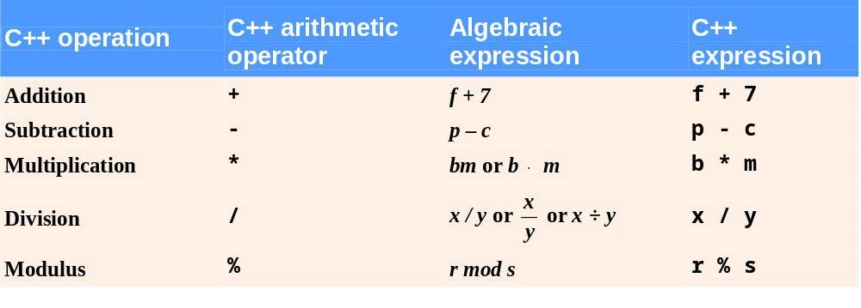
Fig. 2.9 | Arithmetic operators.

Slide 52
2.6 Arithmetic (Cont.)
Rules of operator precedence
  Operators in parentheses are evaluated first
    For nested (embedded) parentheses
      Operators in innermost pair are evaluated first
  Multiplication, division and modulus are applied next
    Operators are applied from left to right
  Addition and subtraction are applied last
    Operators are applied from left to right

Slide 53
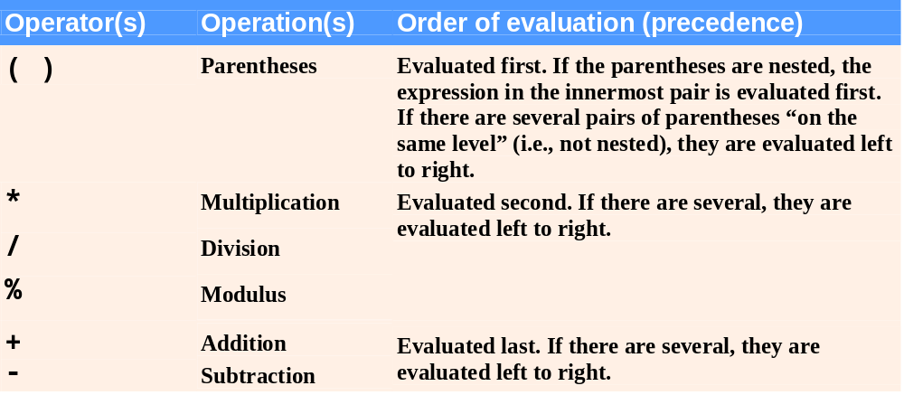
Fig. 2.10 | Precedence of arithmetic operators.

Slide 54
Common Programming Error 2.4
Some programming languages use operators ** or ^ to represent exponentiation. C++ does not support these exponentiation operators; using them for exponentiation results in errors.

Slide 55
Good Programming Practice 2.14
Using redundant parentheses in complex arithmetic expressions can make the expressions clearer.

Slide 56
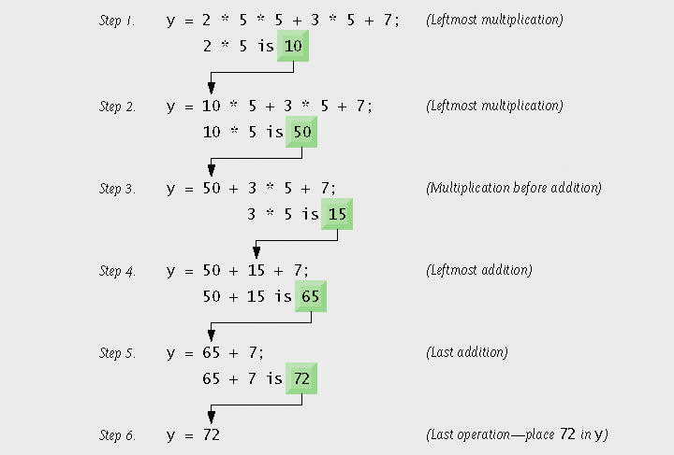
Fig. 2.11 | Order in which a second-degree polynomial is evaluated.

Slide 57
2.7 Decision Making: Equality and Relational Operators
Condition
  Expression can be either true or false
  Can be formed using equality or relational operators
if statement
  If the condition is true, the body of the if statement executes
  If the condition is false, the body of the if statement does not execute

Slide 58
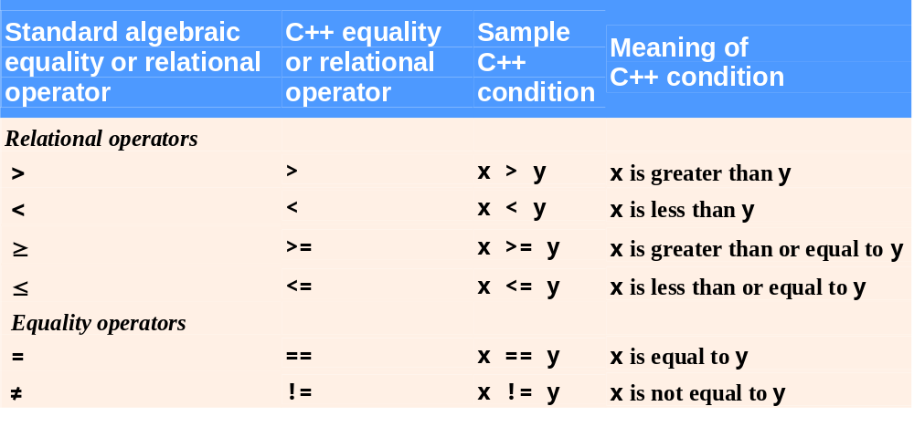
Fig. 2.12 | Equality and relational operators.

Slide 59
Common Programming Error 2.5
A syntax error will occur if any of the operators ==, !=, >= and <= appears with spaces between its pair of symbols.

Slide 60
Common Programming Error 2.6
Reversing the order of the pair of symbols in any of the operators !=, >= and <= (by writing them as =!, => and =<, respectively) is normally a syntax error. In some cases, writing != as =! will not be a syntax error, but almost certainly will be a logic error that has an effect at execution time. (cont…)

Slide 61
Common Programming Error 2.6
You will understand why when you learn about logical operators in Chapter 5. A fatal logic error causes a program to fail and terminate prematurely. A nonfatal logic error allows a program to continue executing, but usually produces incorrect results.

Slide 62
Common Programming Error 2.7
Confusing the equality operator == with the assignment operator = results in logic errors. The equality operator should be read “is equal to,” and the assignment operator should be read “gets” or “gets the value of” or “is assigned the value of.” Some people prefer to read the equality operator as “double equals.” As we discuss in Section 5.9, confusing these operators may not necessarily cause an easy-to-recognize syntax error, but may cause extremely subtle logic errors.

Slide 63
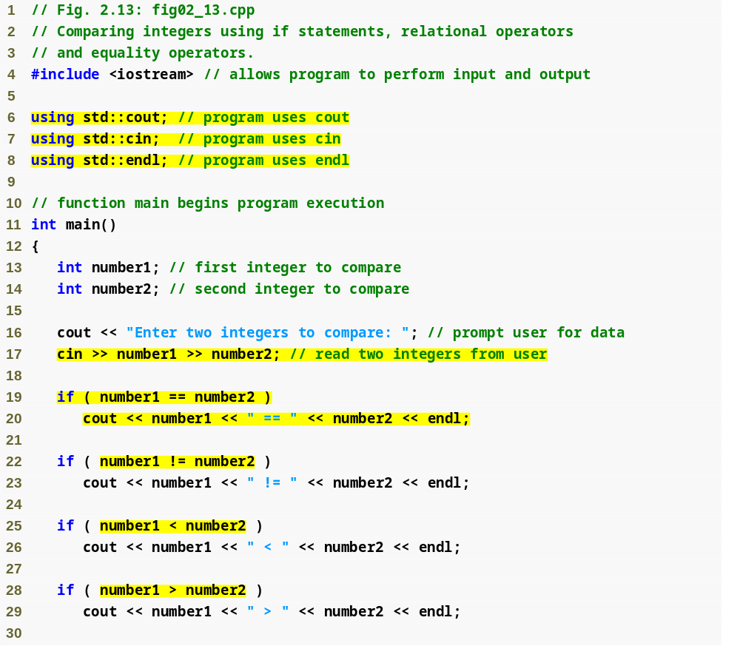
Outline
fig02_13.cpp
(1 of 2)
using declarations eliminate the need for std:: prefix
Declaring variables
You can write cout and cin without std:: prefix
if statement compares the values of number1 and number2 to test for equality
If the condition is true (i.e., the values are equal), execute this statement
if statement compares values of number1 and number2 to test for inequality
If the condition is true (i.e., the values are not equal), execute this statement
Compares two numbers using relational operators < and >

Slide 64
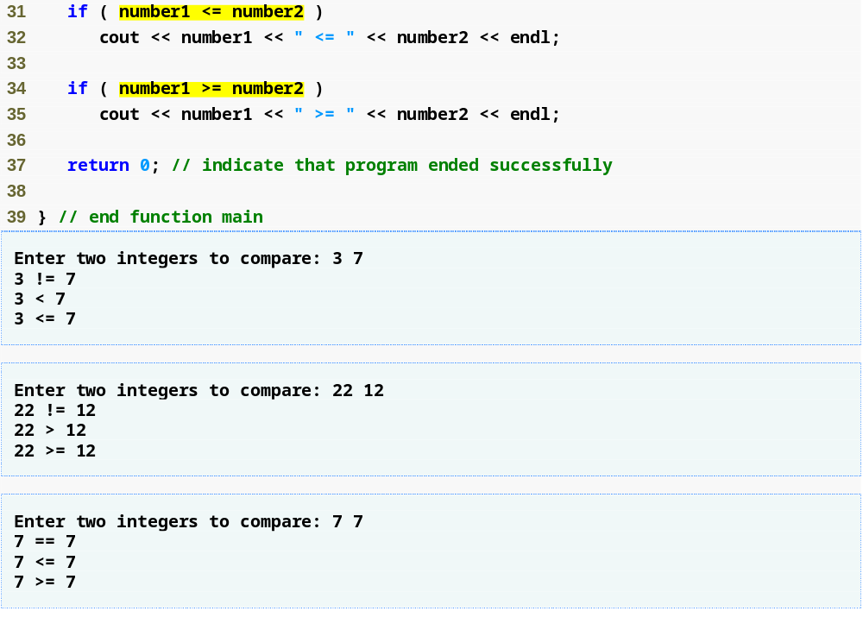
Outline
Compares two numbers using the relational operators <= and >=
fig02_13.cpp
(2 of 2)
fig02_13.cpp output (1 of 3)
(2 of 3)
(3 of 3)

Slide 65
Good Programming Practice 2.15
Place using declarations immediately after the #include to which they refer.

Slide 66
Good Programming Practice 2.16
Indent the statement(s) in the body of an if statement to enhance readability.

Slide 67
Good Programming Practice 2.17
For readability, there should be no more than one statement per line in a program.

Slide 68
Common Programming Error 2.8
Placing a semicolon immediately after the right parenthesis after the condition in an if statement is often a logic error (although not a syntax error). The semicolon causes the body of the if statement to be empty, so the if statement performs no action, regardless of whether or not its condition is true. Worse yet, the original body statement of the if statement now would become a statement in sequence with the if statement and would always execute, often causing the program to produce incorrect results.

Slide 69
Common Programming Error 2.9
It is a syntax error to split an identifier by inserting white-space characters (e.g., writing main as ma in).

Slide 70
Good Programming Practice 2.18
A lengthy statement may be spread over several lines. If a single statement must be split across lines, choose meaningful breaking points, such as after a comma in a comma-separated list, or after an operator in a lengthy expression. If a statement is split across two or more lines, indent all subsequent lines and left-align the group of indented.

Slide 71
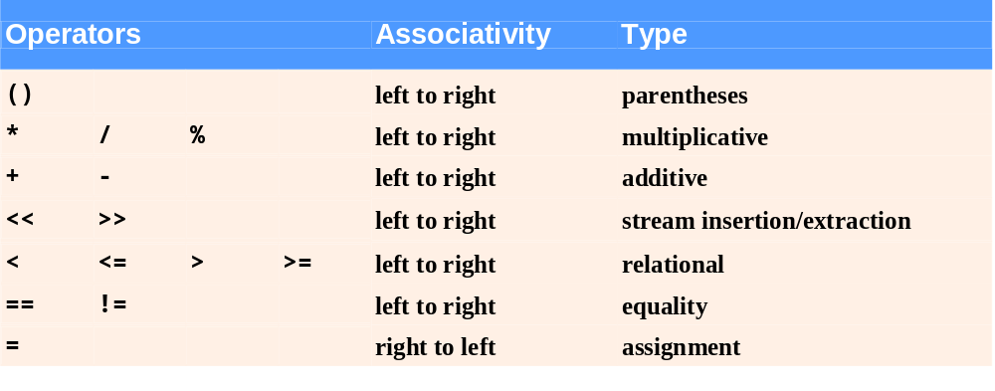
Fig. 2.14 | Precedence and associativity of the operators discussed so far.

Slide 72
Good Programming Practice 2.19
Refer to the operator precedence and associativity chart when writing expressions containing many operators. Confirm that the operators in the expression are performed in the order you expect. If you are uncertain about the order of evaluation in a complex expression, break the expression into smaller statements or use parentheses to force the order of evaluation, exactly as you would do in an algebraic expression. Be sure to observe that some operators such as assignment (=) associate right to left rather than left to right.

Slide 73
2.8 (Optional) Software Engineering Case Study: Examining the ATM Requirements Document
Object-oriented design (OOD) process using UML
  Performed in chapters 3 to 7, 9 and 13
  Requirements document
    Specifies overall purpose and what the system must do
Object-oriented programming (OOP) implementation
  Complete implementation in appendix G

Slide 74
2.8 (Optional) Software Engineering Case Study (Cont.)
Requirements document
  New automated teller machine (ATM)
  Allows basic financial transaction
    View balance, withdraw cash, deposit funds
  User interface
    Display screen, keypad, cash dispenser, deposit slot
  ATM session
    Authenticate user, execute financial transaction

Slide 75
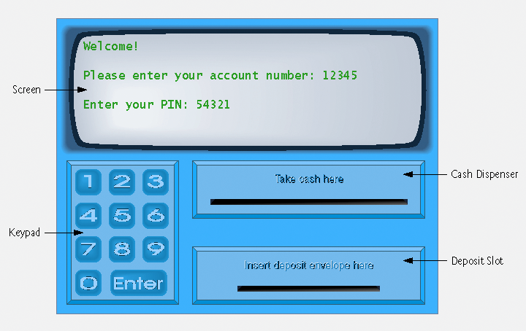
Fig. 2.15 | Automated teller machine user interface.

Slide 76
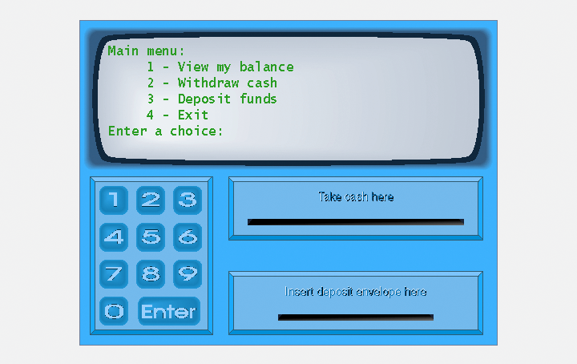
Fig. 2.16 | ATM main menu.

Slide 77
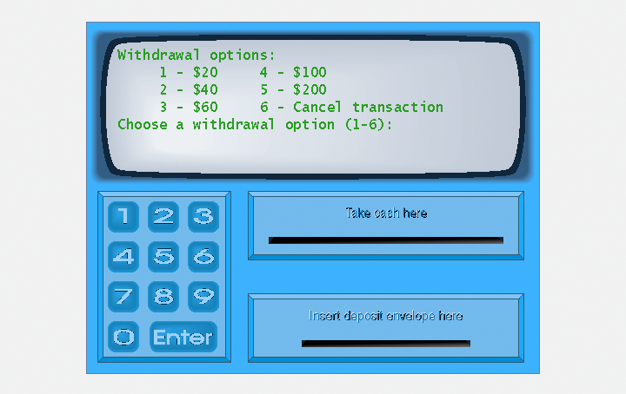
Fig. 2.17 | ATM withdrawal menu.

Slide 78
2.8 (Optional) Software Engineering Case Study (Cont.)
Analyzing the ATM system
  Requirements gathering
  Software life cycle
    Waterfall model
    Iterative model
  Use case modeling
Use case diagram
  Models the interactions between clients and the system
  Actor
    External entity

Slide 79
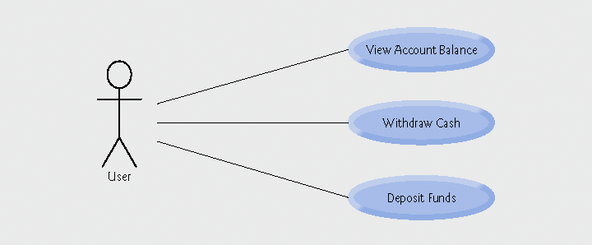
Fig. 2.18 | Use case diagram for the ATM system from the user’s perspective.

Slide 80
2.8 (Optional) Software Engineering Case Study (Cont.)
UML diagram types
  Model system structure
    Class diagram
      Models classes, or “building blocks” of a system
      Screen, keypad, cash dispenser, deposit slot.

Slide 81
2.8 (Optional) Software Engineering Case Study (Cont.)
  Model system behavior
    Use case diagrams
      Model interactions between the user and the system
    State machine diagrams
      Model the ways in which an object changes state
    Activity diagrams
      Model an object’s activity during program execution
    Communication diagrams (collaboration diagrams)
      Model the interactions among objects
      Emphasize what interactions occur
    Sequence diagrams
      Model the interactions among objects
      Emphasize when interactions occur

Slide 82
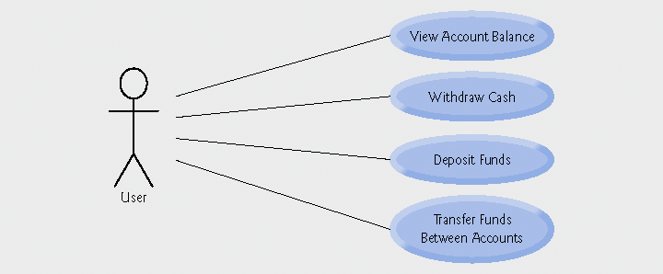
Fig. 2.19 | Use case diagram for a modified version of our ATM system that also allows users to transfer money between accounts.

